Slide 1
Week 7 CIS 215
firewalls

Slide 2
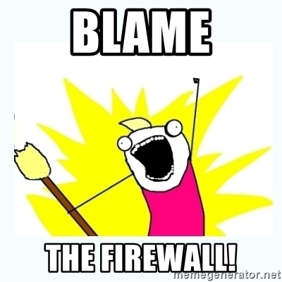
What is a firewall?
Monitor traffic
Ingress and Egress (in and out) traffic can be monitored and controlled
A way to separate your network from the WWW (World Wide Web)
Used as a blame for everything that goes wrong

Slide 3
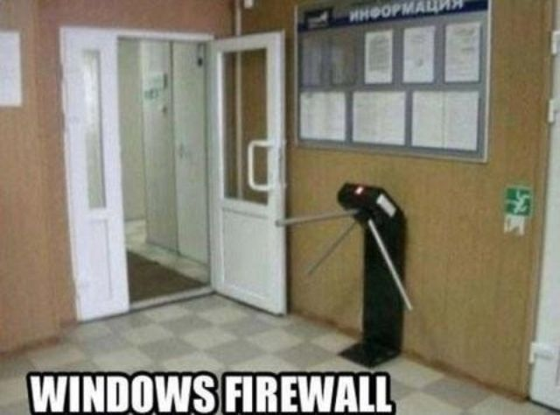
How are firewalls different on different operating systems?
Different Operating Systems use different types of firewalls and have different ways to interact with the firewall
Ubuntu – UFW
Red Hat (centOS)- Firewalld
Microsoft – Windows Defender Firewall

Slide 4
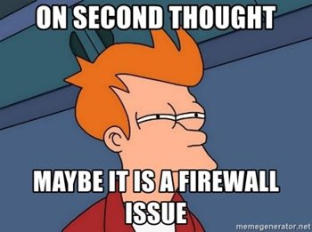
What kinds of firewalls are there?
There are multiple ways to sort out firewalls
Hardware vs Software
Stateful vs Stateless
Network vs Host
Static vs Dynamic
But, what's, you know, THE BEST
Packet Firewall is the most basic
Combos!

Slide 5
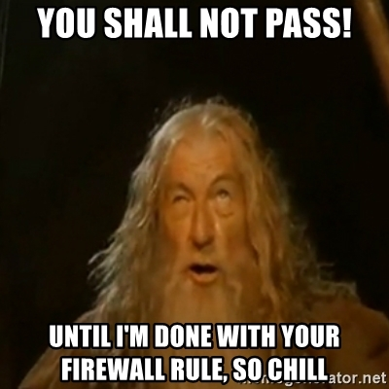
Allow all vs deny all
Firewalls that work with packets have rules
Rules must have a default if no other rules apply
Deny all
More Secure
Needs more work to keep up to date
Allow all
Less secure
Needs less hands-on watching

Slide 6
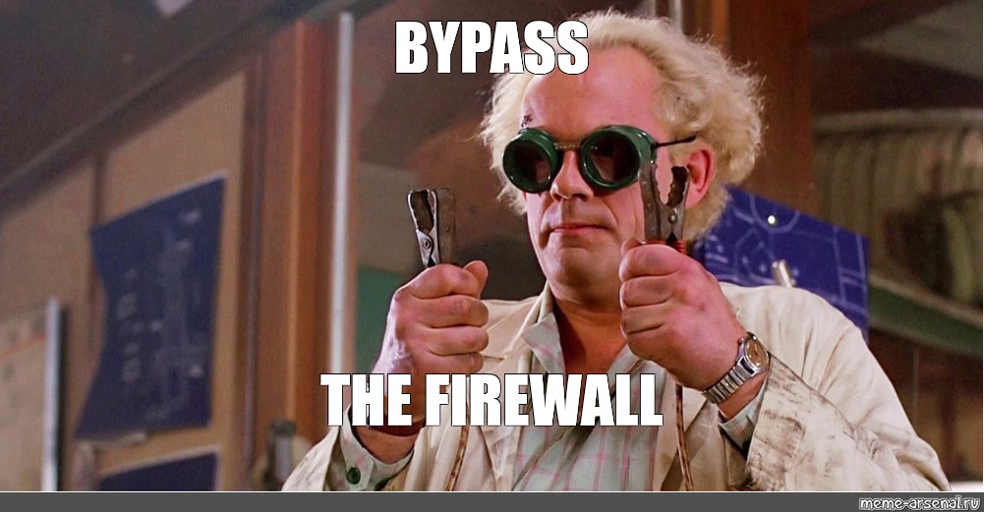
What firewalls are NOT good at
Any Social Engineering threats
If you don't know the issue is coming you can't tell the firewall to protect you from it
They are reactive not proactive

Slide 7
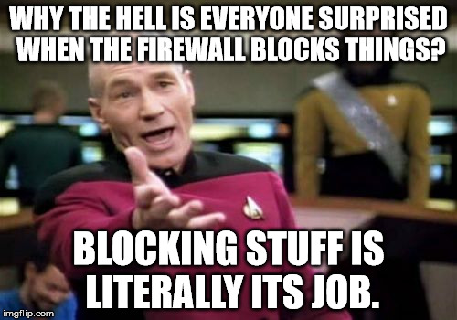
What firewalls are good protection for
Prevents some unauthorized remote access
Not all! Scammers can get through on Browsers still
Social Engineering and viruses can still give up access
Extra layer of protection for legacy systems.
Block access to sites
For example, employees on social media can be blocked
Can give extra info in logs of ingress/egress on network

Slide 8
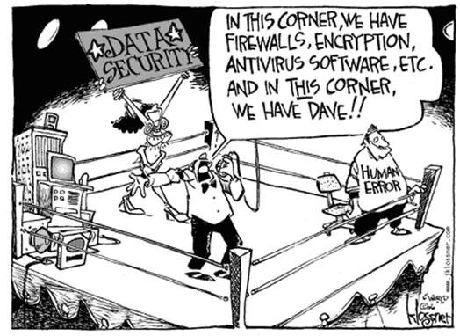
Ok, but why do I care for security
Hardening of the system
In security we need to protect systems by knowing how they are setup and where the limits are
Blue Team
Testing limits of the system
Pen testing
Red Team
https://community.spiceworks.com/topic/497931-and-in-this-corner-we-have-dave-funny-cartoon

Slide 9
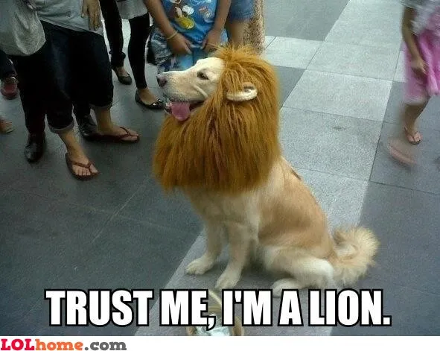
What do most companies do with firewalls?
Layered approach
Multiple vendors (Swiss cheese model)
DMZ

